Slide 1
E-Commerce Analysis
Performance and Retention Insights
Project By : Chirag Bais

Slide 2

Introduction
This presentation analyzes the key metrics and trends of an e-commerce platform, focusing on business performance and customer behavior. Using SQL-based data insights, it covers revenue figures, customer purchase patterns, and retention strategies to drive growth and profitability.

Slide 3
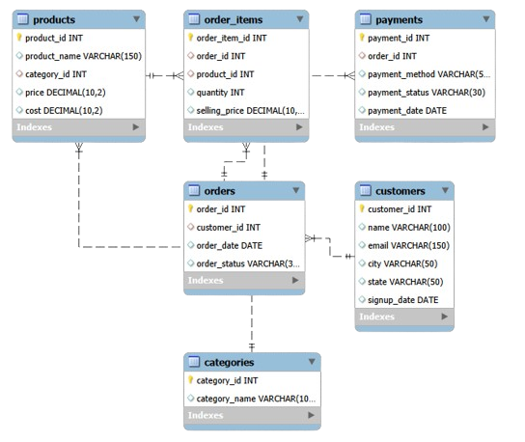
Data Model

Slide 4
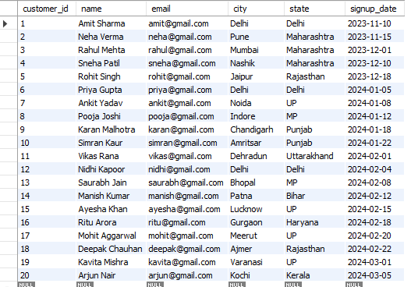
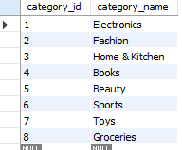
Table View

Slide 5
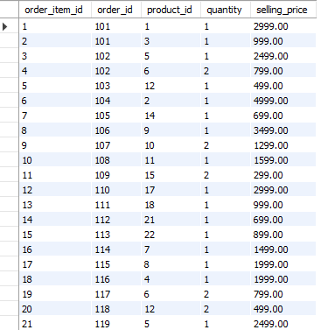
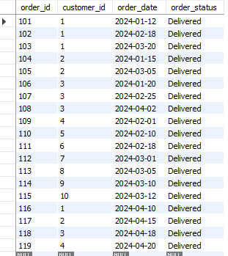
Table View

Slide 6
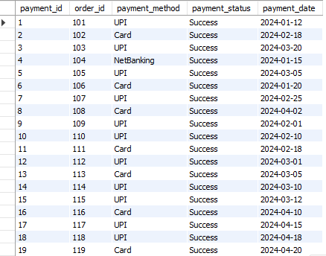
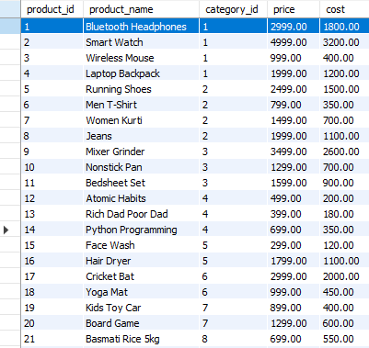
Table View

Slide 7


1. What is the total revenue generated by the platform?

Slide 8
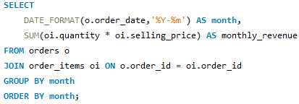

2. How does revenue trend on a month-by-month basis?

Slide 9
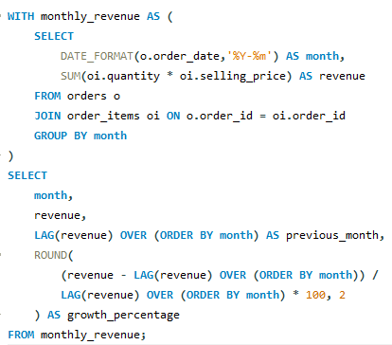

3. What is the month-over-month revenue growth rate?

Slide 10
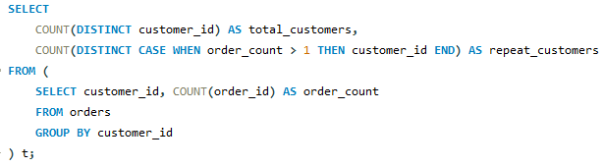

4. How many customers are repeat customers compared to total customers?

Slide 11
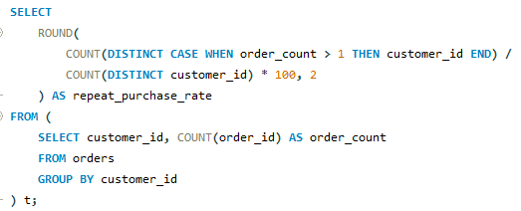

5. What is the repeat purchase rate of customers?

Slide 12
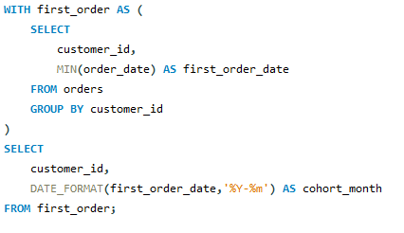
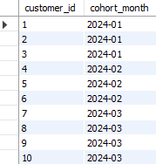
6. In which month did each customer place their first order?

Slide 13
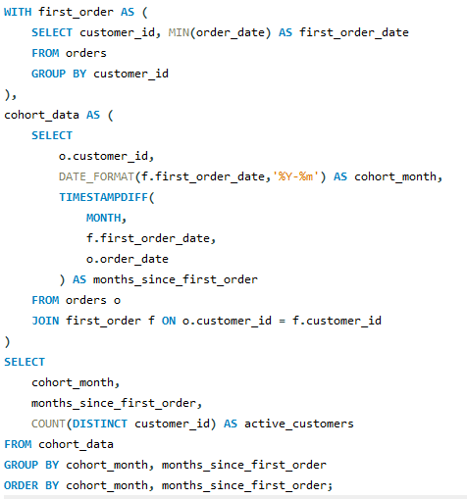
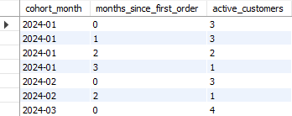
7. How does customer retention change over time for each cohort?

Slide 14
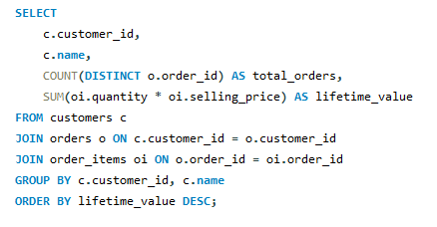
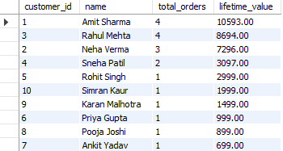
8. What is the lifetime value of each customer?

Slide 15
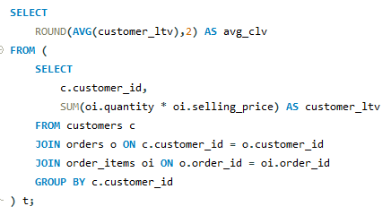

9. What is the average customer lifetime value?

Slide 16
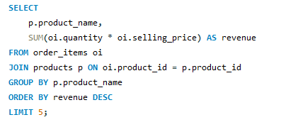
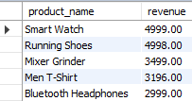
10. Which products generate the highest revenue?

Slide 17
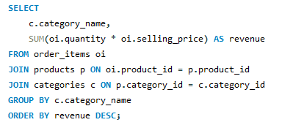
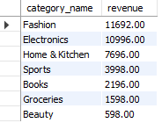
11. How much revenue does each product category contribute?

Slide 18
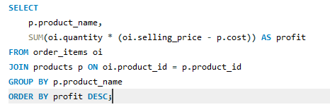
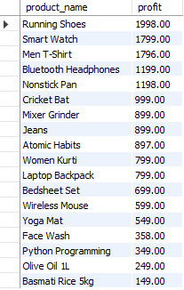
12. Which products are the most profitable?

Slide 19
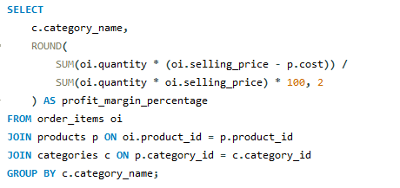
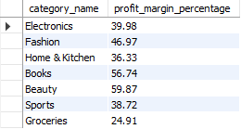
13. What is the profit margin for each product category?

Slide 20
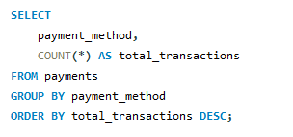

14. Which payment methods are most frequently used by customers?

Slide 21
CONCLUSION
I am Chirag Bais, a Data Analyst, and this project demonstrates how SQL can be used to analyze real-world e-commerce data to drive business decisions. Using core data analysis tools such as MySQL, I analyzed revenue trends, customer retention, cohort behavior, customer lifetime value (CLV), product profitability, and payment preferences. This analysis highlights how structured data querying can uncover actionable insights that help improve customer retention, optimize product strategy, and increase overall business performance. This project represents the most important takeaway of the presentation—turning raw data into clear, business-ready insights using data analysis tools
https://github.com/Chiragbais8482/E-Commerce-Performance-Retention-Analysis

